Slide 1

S&P500 Stock Index Analysis
DATA 603 FINAL PROJECT
Instructor: Prof. Donghwa Kim
Daksh Intwala

Slide 2

DOMAIN – STOCK MARKET
US citizens trade/use/own securities - 58% ~ 191 million people
US citizens trade/use/own crypto currency 59 million people
Average Volume traded on S&P500 - 3,805,355,000 as of 8/15/22.
References:
https://news.gallup.com/poll/266807/percentage-americans-owns-stock.aspx
https://finance.yahoo.com/quote/%5EGSPC/

Slide 3

DATASET INTRODUCTION
Dataset used in the project has 7 fields:
Date - (string format) the day for which the data is recorded. In stocks it shows 9:30am - 4pm.
Open - (double) Opening price of the stock
High - (double) Highest price of the stock during the day
Low - (double) Lowest price of the stock
Close - (double) Closing price of the stock
Adj. Close - (double) Adjacent Closing price of the stock (Price value after accounting)
Volume - (double) Number of the stock traded.
Data Size : 3401.1 MB
Data Source: https://www.kaggle.com/datasets/paultimothymooney/stock-market-data

Slide 4
PROBLEM
Importance of Time in Stocks
Understanding Trend
Beginners find hard to spot details from history

Slide 5


BIG DATA TECH USE CASES
Real-time Stock Market Insight
Developing Financial Models
Risk Detection
Customer Analytics

Slide 6

TOP 10 S&P500 STOCKS
Apple Inc. (AAPL)
Microsoft Corp. (MSFT)
Amazon.com, Inc. ( AMZN)
Tesla, Inc. (TSLA)
Alphabet Inc. Class A (GOOGL)
Alphabet Inc. Class C (GOOG)
Nvidia Corp. (NVDA)
Berkshire Hathaway Inc. (BRK.B)
Meta Platforms, Inc. Class A (META)
UnitedHealth Group Inc. (UNH)

Slide 7

ANALYSIS METHOD
Data Retrieval
Average Prices
PySpark Dataframe Analysis
Visualization
Training LSTM Model

Slide 8

QUERIES
January 31st 2022 saw highest opening market average considering all S&P500 stocks.
Probably due to improvement in market followed by rally of large cap companies.
“Meanwhile, the S&P 500 climbed 2.4% to end at 4,431.85, its best day since June 2020”
Reference:
https://www.nasdaq.com/articles/stock-market-news-for-jan-31-2022

Slide 9

QUERIES
On January 29th 2022, S&P500 stocks’ average intra-day swing was highest of 23 points.
This implies that stocks of S&P500 had great swing of 23 avg. points which can be related with the fact that January 2022 remained worst performing month since March 2020.

Slide 10
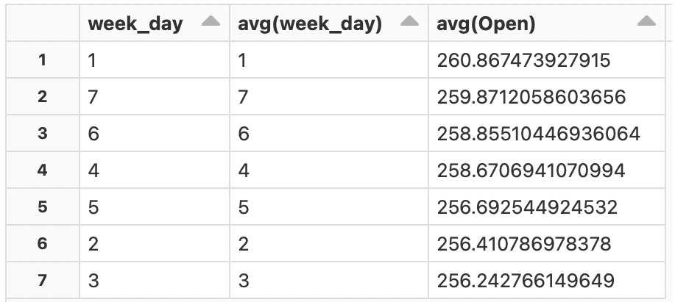

QUERIES
Sunday trend, stocks on Sunday in S&P500 have higher opening price average.
Because, though weekends is not considered regular trading days, after hours trading can be done. In presence of low volume, stocks become much more volatile to news, announcements and events.

Slide 11
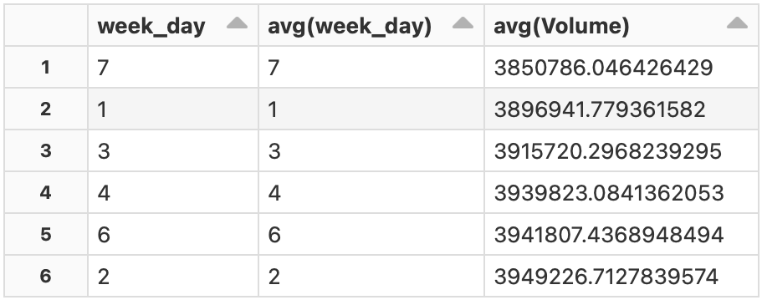

QUERIES
The lowest volume is seen on Sunday, but its more common for investors to trade in regular trading hours.
So best point for investors to enter S&P500 is Monday morning where trading volume is ramped up and stocks are more volatile to find low entry zone.
Also, beginners can find safe entry point on Tuesday which is lowest volume in week days.

Slide 12
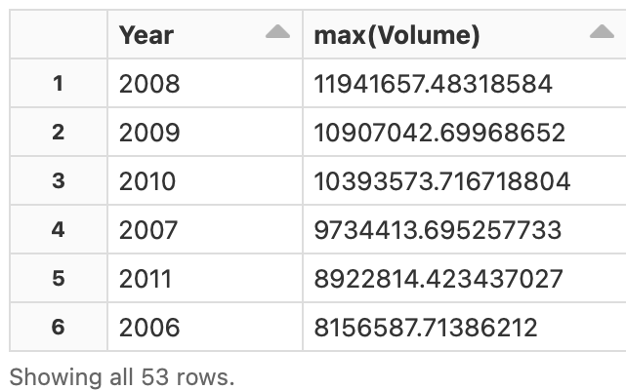

QUERIES
2008 had highest trading volume average for stocks in S&P500.
The reason seems obvious due to Great Recession.

Slide 13
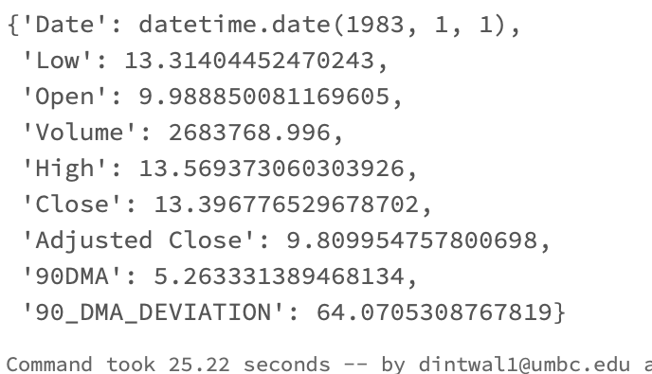

QUERIES
Quarterly moving average, is 64% .
Means, most of the S&P500 stocks are seeing upwards trend each quarter.
(Window function - Deviation)

Slide 14
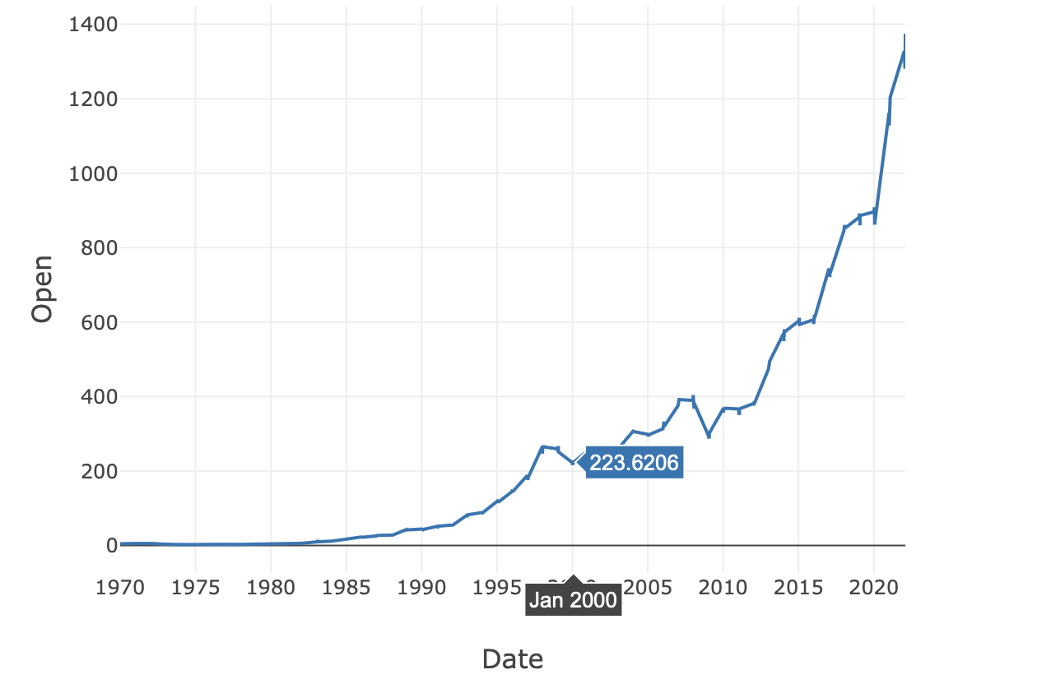
VISUALIZATION
Average Opening Price
Dot com Crash

Slide 15
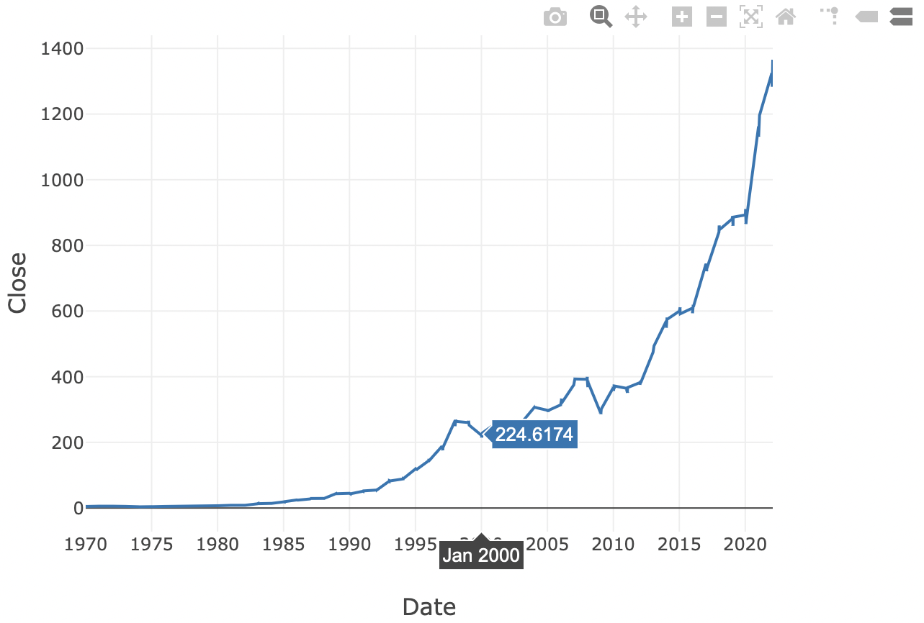
VISUALIZATION
Average Closing Price
For Beginners:
No major change from opening price
For Pros:
Though seems similar but changes in decimal points gives good entry position for big investors.

Slide 16
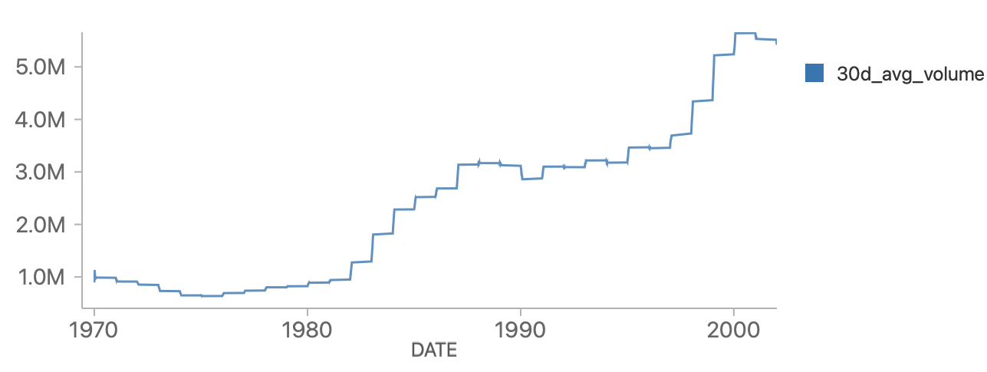
VISUALIZATION
Average Volume Monthly Trend
The OPEC oil embargo of October 1973 and the Watergate scandal that led to President Nixon's resignation in August 1974

Slide 17
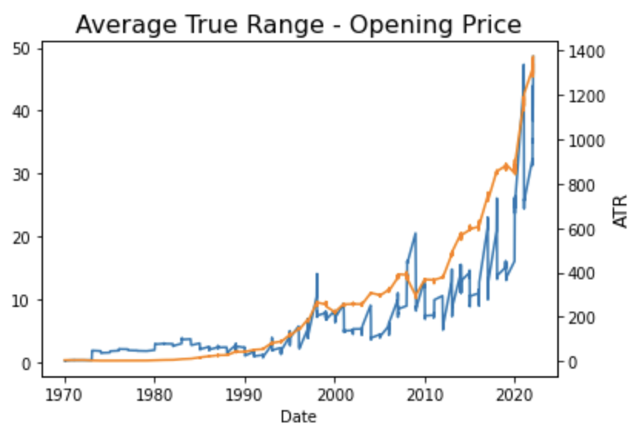
VISUALIZATION
Average True Rang – Volatility Measure
Covid pandemic
2016 US election
Great Recession

Slide 18
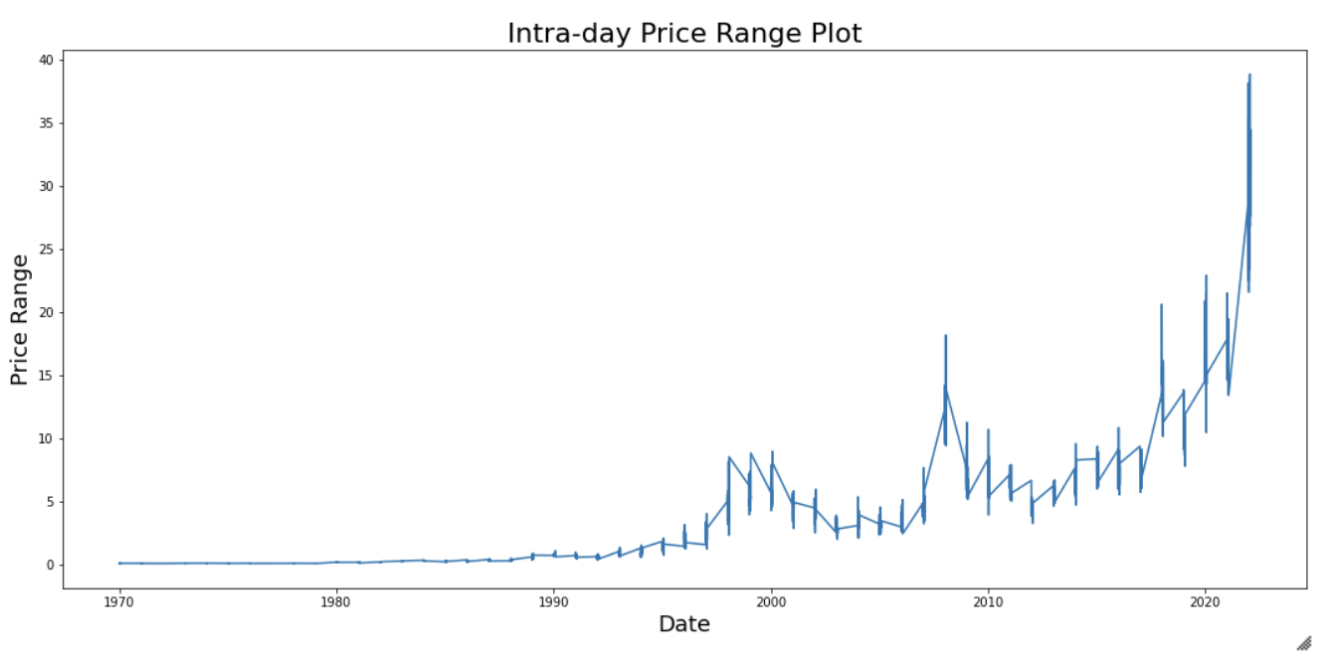
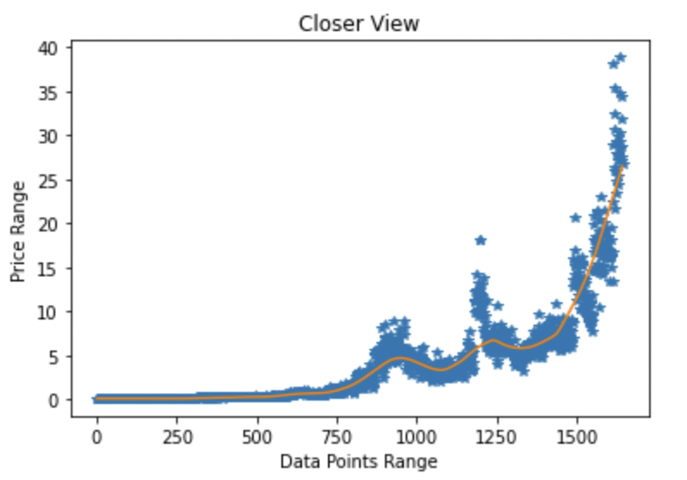
VISUALIZATION
Variations Increased
Trend Line
Intra day Price Variation Plot

Slide 19

Stacked LSTM
70/30 Manual Split
Scaling - MinMaxScaler
Opening Price as target variable
2 LSTM layers and an output layer
Prediction

Slide 20
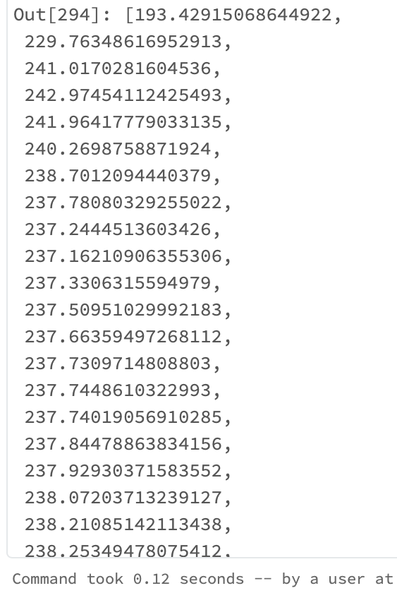
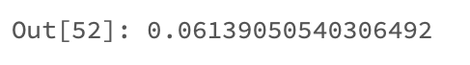

Stacked LSTM
Mean Squared Error
Predictions
Test Data

Slide 21

Conclusion
S&P500 Stocks
Projects Upward Trend
Less Volatile
Safe for Beginner Investors as low average intra-day swing
Has potential for corrections due to involvement of large cap stocks.

Slide 22

THANK YOU
Made By:
Daksh Intwala
BT70416
dintwal1@umbc.edu

